Slide 1
Building, Running, Patching Docker Containers – The Paradigm Shift
Steve Lasker
Program Manager – Azure Developer Experiences
@stevelasker
BRK2115
Notes:
Building Resilient Microservices with .NET Core and Azure Container Services (AKS)
Code: BRK2141
Type: Breakout 45 minute
Track(s): Applications and Infrastructure
Speaker(s): Glenn Condron, Steve Lasker
Timeslot: Monday, May 7 2:45 PM-3:30 PM
Abstract:Microservices are highly scalable, resilient, and composable units of deployment for modern applications. But building them is hard. There are a lot of development and deployment considerations to take into account. In this session we'll show you how we're making .NET Core microservices easier to build with new application patterns in .NET Core 2.1 as well as how to deploy and manage them with Kubernetes and Helm.

Slide 2
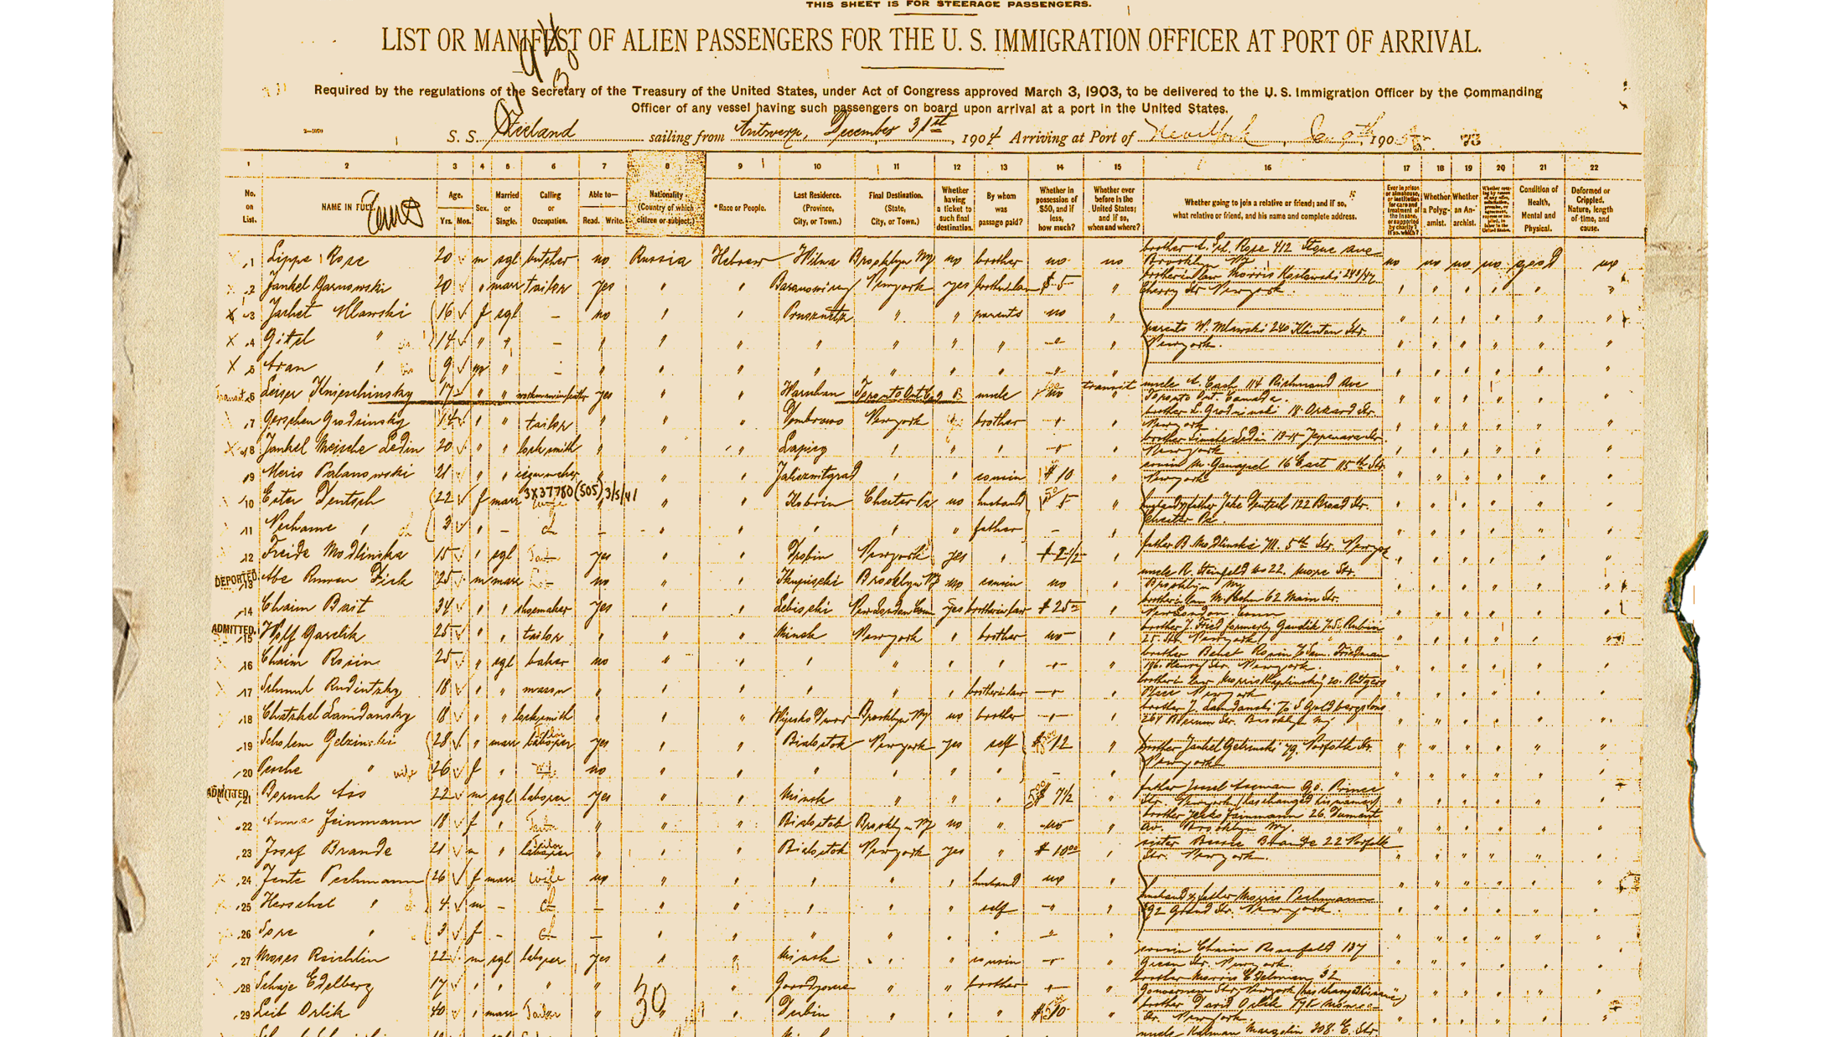
Shipping Manifest
Building
Building your code, with a container first mindset
Running
Prepare your code to run
Deploying updates to your code
Patching
Patching – the paradigm shift
Reaping the rewards of your efforts

Slide 3

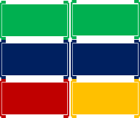
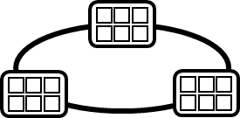


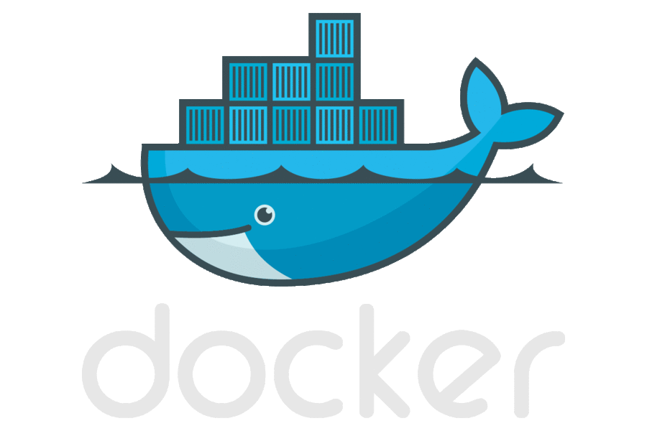
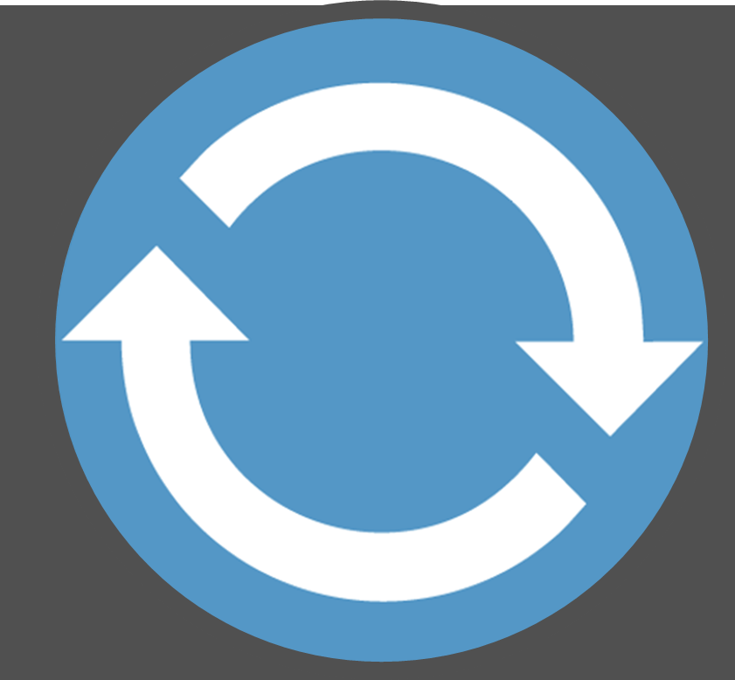

Today’s Container DevOps Workflow
Container Service
OS & Framework Patching
What happens when developers stop making code changes?
Run, Manage
Container Instances
Source Code Control
(SCC)
Build/CI,
Integrate,
Test
CD, Deploy
App Services
Production
environments
Service Fabric
SQL Data Services
coming soon
Inner-Loop
…
Run
Monitor and Diagnose
Code
Validate
Debug

Slide 4
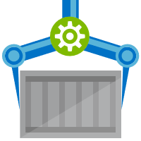
ACR Build
Native Container Build Service
Follows docker build semantics
docker build –t helloworld:v1 .
az acr build –t helloworld{{.Build.ID}} .
Inner-loop pre check-in validations
Trigger based builds (git commits, base image updates)
az acr build-task create –-image helloworld{{.Build.ID}}
--name myBuildTask
--registry jengademos
--context https://github.com/me/helloworld
--branch master
--git-access-token $PAT

Slide 5





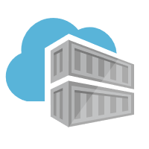


ACR Build: Container OS & Framework Patching
.NET
Registries
Docker Hub
MCR
ACR
Build Triggers
SCC Providers
ACR Build
Azure Container Registry
aka.ms/acr/build

Slide 6
Demo
ACR Build
Inner loop
trigger builds on git commits
but, wait, there’s more…

Slide 7
I want a CLI to test building images, before I commit my code (Inner Loop)
docker build -t helloworld:v1 .
Sending build context (2.452MB) to ACR Build as Id: eu2-a3e8a221
Step 1/17 : FROM microsoft/aspnetcore:2.0 AS base
...
Default the target registry
az configure --defaults acr=$ACR_NAME
az acr build -t helloworld:v1 .
Sending build context (2.452MB) to ACR Build as Id: eu2-a3e8a221
Step 1/17 : FROM microsoft/aspnetcore:2.0 AS base
Step 4/17 : FROM microsoft/aspnetcore-build:2.0 AS build
Step 7/17 : COPY AspNetCore/AspNetCore.csproj AspNetCore/
Step 9/17 : COPY . .
Step 11/17 : RUN dotnet build -c Release -o /app
Build succeeded.
Step 12/17 : FROM build AS publish
Step 13/17 : RUN dotnet publish -c Release -o /app
Step 14/17 : FROM base AS final
Step 16/17 : COPY --from=publish /app .
Step 17/17 : ENTRYPOINT ["dotnet", "AspNetCore.dll"]
Successfully built 55ce464887aa
Pushing stevelasdemos.azurecr.io/helloworld:252351
Push complete
ACR Builder discovered the following dependencies:
[{"image":{"registry":"jengademos.azurecr-test.io","repository":"helloworld","tag":"v4","digest":"sha256:dafc036af5d7df517efd2d24df1360a0a2c753828a"}, "runtime-dependency": {"registry":"registry.hub.docker.com", "repository":"microsoft/aspnetcore", "tag":"2.0", "digest":"sha256:3dd91dfc75309d7b9b03e7ce2b553746be17"},"buildtime-dependency":[{"registry":"registry.hub.docker.com","repository":"microsoft/aspnetcore-build","tag":"2.0","digest":"sha256:8314a18ed2a4971a7628be46fecc469082afe0689815351cd9d6b62e9823eae6"}]}]
ACR Build follows same semantics as docker build

Slide 8
Committing Code
Are you ready to deploy?
Can your container be built?
What about configuring build systems…

Slide 9






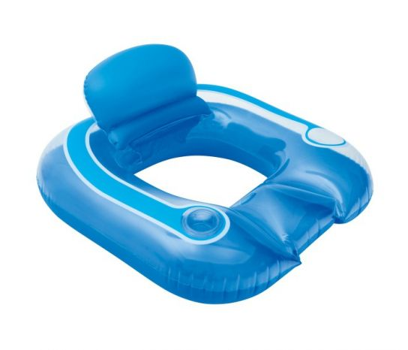

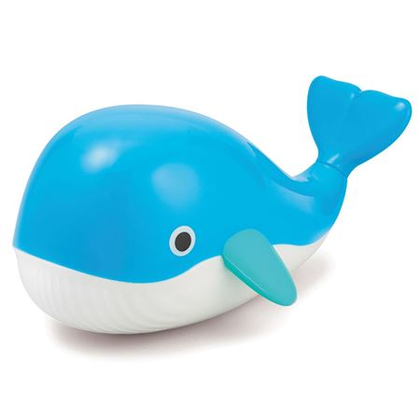


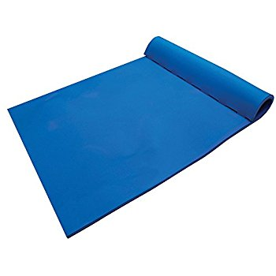
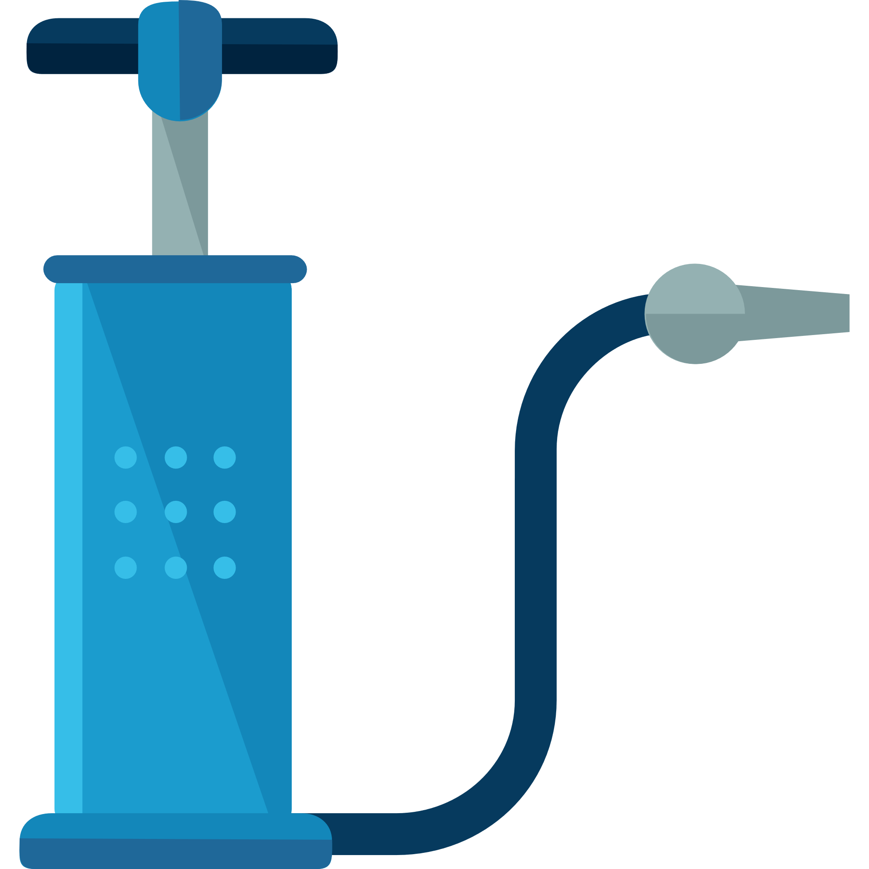


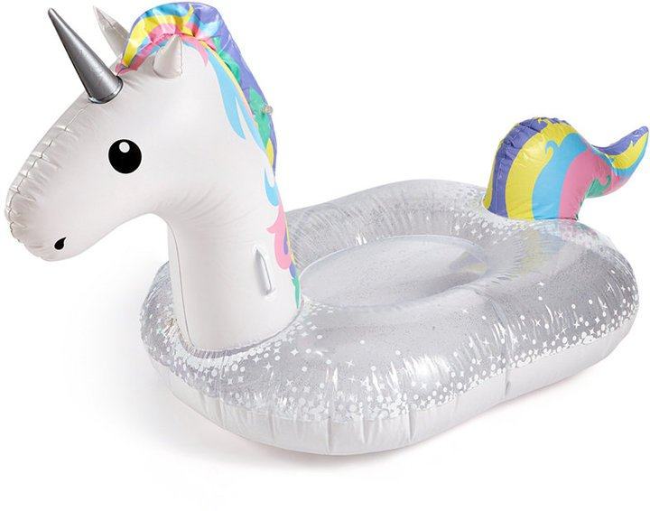



Current Build Infrastructure
Build, Integrate, Test
Hosted Build Agent Pool
Contoso – Build Pool
Northwind – Build Pool

Slide 10
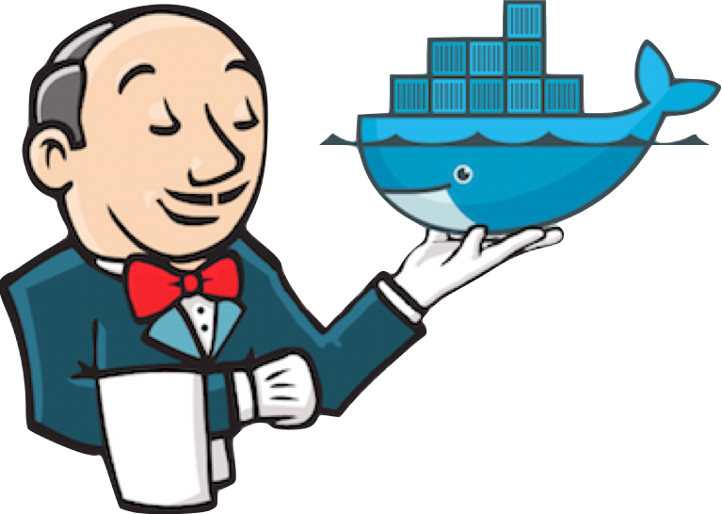
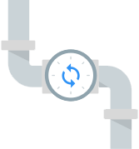


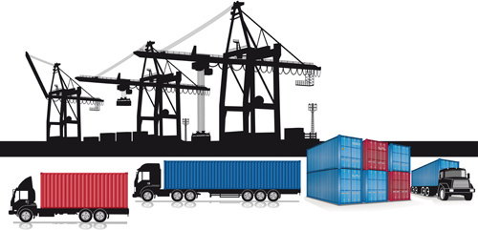
Native Container Builds
Build, Integrate, Test
Hosted Build Agent Pool

Slide 11
Announcing ACR Build

Slide 12
Testing Built Containers…

Slide 13
Testing Built Containers
FROM microsoft/aspnetcore:2.0 AS base
WORKDIR /app
EXPOSE 80
FROM microsoft/aspnetcore-build:2.0 AS builder
ARG BuildConfiguration=Release
WORKDIR /src
COPY *.sln ./
COPY Web/Web.csproj Web/
RUN dotnet restore
COPY . .
WORKDIR /src/Web
RUN dotnet build -c $BuildConfiguration -o /app
FROM builder AS publish
ARG BuildConfiguration=Release
RUN dotnet publish -c $BuildConfiguration -o /app
FROM base AS production
WORKDIR /app
COPY --from=publish /app .
ENTRYPOINT ["dotnet", "Web.dll"]
FROM microsoft/aspnetcore:2.0 AS base
WORKDIR /app
EXPOSE 80
FROM microsoft/aspnetcore-build:2.0 AS builder
ARG BuildConfiguration=Release
WORKDIR /src
COPY *.sln ./
COPY Web/Web.csproj Web/
RUN dotnet restore
COPY . .
WORKDIR /src/Web
RUN dotnet build -c $BuildConfiguration -o /app
FROM builder AS test
WORKDIR /src/Web.test
RUN dotnet test
FROM builder AS publish
ARG BuildConfiguration=Release
RUN dotnet publish -c $BuildConfiguration -o /app
FROM base AS production
WORKDIR /app
COPY --from=publish /app .
ENTRYPOINT ["dotnet", "Web.dll"]
Unit Tests
Multi-stage dockerfiles
Functional Tests
Test containers
test:1
web:1
test:1
web:1
Integration Env

Slide 14
Demo
.NET Core 2.1
Coding for Failure

Slide 15
Coming into port…
Building 100% reliability is like chasing chickens
Accept failure and you’ll sleep well at night
Use the modern tools and technologies
Containers are the “unreliable” packaging format
Orchestrators (Kubernetes) are your nighttime managers
Take the time to fully adapt – this is a paradigm shift
.NET Core 2.1 provides coding for the unreliable pattern

Slide 17
ACR Build
A feature of Azure Container Registry
aka.ms/acr/build
@SteveLasker
blogs.msdn.microsoft.com/SteveLasker

